Slide 1
Introduction to Transformer
Quang Duong

Slide 2
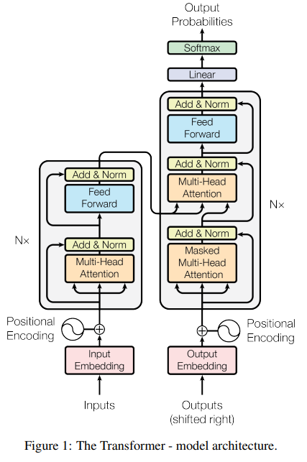
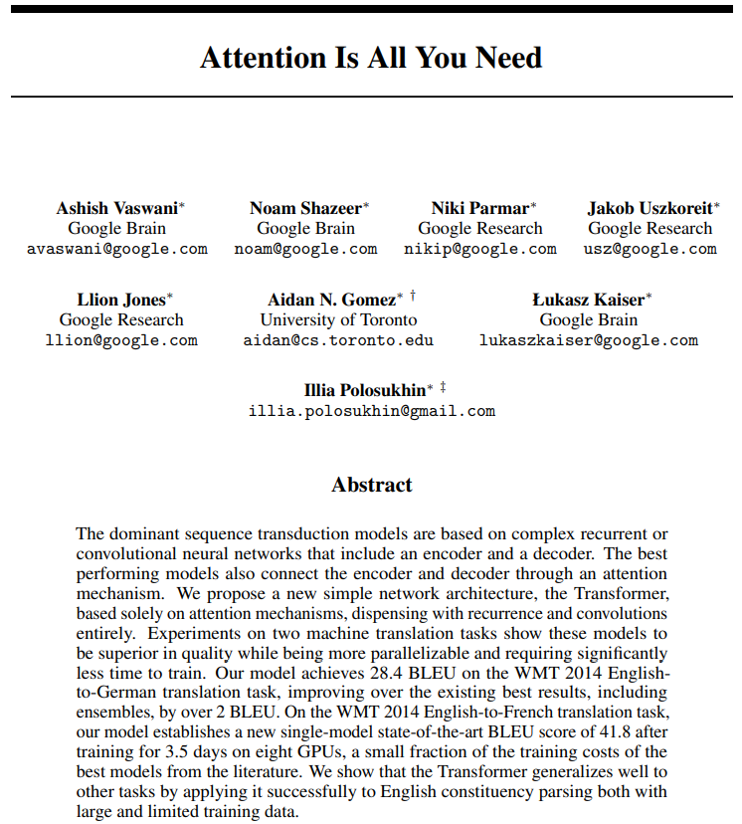
Transformer's origin
Attention Is All You Need, A. Vaswani et al, 2017, https://arxiv.org/abs/1706.03762

Slide 3


Transformer for lingual translation
Prediction:
"Je vais bien"
Transformer
Decoder
Encoder
Source:
"I am fine"
Simplified transformer architecture

Slide 4
Model requirements for data input
Source:
Target/Label:
"I am fine"
"Je vais bien"
"Thank you very much"
"Merci beaucoup"
"I cook French cuisine"
"Je fais la cuisine française"
Model only understand numerical value -> transform from text to numerical representation
Source and target texts may have different word length -> A fixed sequence length is needed for the model processing
Model need to know when to start and notify when to end its prediction

Slide 5
Tokenizer
Contain large vocabulary dictionary
Transform text to numerical representation
Special tokens
UNK: Unkown
PAD: Padding
SOS: Start Of Sentence
EOS: End Of Sentence
{
…
"vocab": {
"[UNK]": 0,
"[PAD]": 1,
"[SOS]": 2,
"[EOS]": 3,
"I" : 9,
"you": 24,
"very": 75,
"am" : 107,
"much": 120,
"fine": 550,
"French": 582
"cook": 1779,
"Thank": 2089,
}
…
}
tokenizer

Slide 6
Tokenizer – Source language – Encode
Tokenizer
encode
"I am fine"
[9, 107, 550]
{
…
"vocab": {
"[UNK]": 0,
"[PAD]": 1,
"[SOS]": 2,
"[EOS]": 3,
"I" : 9,
"you": 24,
"very": 75,
"am" : 107,
"much": 120,
"fine": 550,
"French": 582
"cook": 1779,
"Thank": 2089,
}
…
}
> text = "I am fine"
> tokenizer_source.encode(text).ids
# [9, 107, 550]
tokenizer_source

Slide 7
Tokenizer – Source language – Decode
Tokenizer
decode
[9, 107, 550]
"I am fine"
{
…
"vocab": {
"[UNK]": 0,
"[PAD]": 1,
"[SOS]": 2,
"[EOS]": 3,
"I" : 9,
"you": 24,
"very": 75,
"am" : 107,
"much": 120,
"fine": 550,
"French": 582
"cook": 1779,
"Thank": 2089,
}
…
}
> id_list = [9, 107, 550]
> tokenizer_source.decode(id_list)
# "I am fine"
tokenizer_source

Slide 8
Tokenizer – Target language - Encode
Tokenizer
encode
"Je vais bien"
[69, 600, 71]
{
…
"vocab": {
"[UNK]": 0,
"[PAD]": 1,
"[SOS]": 2,
"[EOS]": 3,
"la": 9,
"Je": 69 ,
"bien": 71,
"beaucoup": 324,
"vais": 600,
"fais": 1355,
"cuisine": 1390,
"Merci": 3546,
"française": 5309,
}
…
}
> text = "Je vais bien"
> tokenizer_target.encode(text).ids
# [69, 600, 71]
tokenizer_target

Slide 9
Tokenizer – Target language - Decode
Tokenizer
decode
[69, 600, 71]
"Je vais bien"
{
…
"vocab": {
"[UNK]": 0,
"[PAD]": 1,
"[SOS]": 2,
"[EOS]": 3,
"la": 9,
"Je": 69 ,
"bien": 71,
"beaucoup": 324,
"vais": 600,
"fais": 1355,
"cuisine": 1390,
"Merci": 3546,
"française": 5309,
}
…
}
> id_list = [69, 600, 71]
> tokenizer_target.decode(id_list)
# "Je vais bien"
tokenizer_target

Slide 10
Fixed sequence length – SOS, EOS, PAD
Choose fixed sequence length : 7
Source:
"I am fine"
"Thank you very much"
"I cook French cuisine"
Max sequence length: 4
SOS | I | am | fine | EOS | PAD | PAD
SOS | Thank | you | very | much | EOS | PAD
SOS | I | cook | French | cuisine | EOS | PAD
For encoder input
For decoder input
SOS | Je | vais | bien | PAD | PAD | PAD
SOS | Merci | beaucoup | PAD | PAD | PAD | PAD
SOS | Je | fais | la | cuisine | française | PAD
Target:
"Je vais bien"
"Merci beaucoup"
"Je fais la cuisine française"
Max sequence length: 5
Je | vais | bien | EOS | PAD | PAD | PAD
Merci | beaucoup | EOS | PAD | PAD | PAD | PAD
Je | fais | la | cuisine | française | EOS | PAD
For loss calculation

Slide 11
Put it all together (1/3)
Sequence length: 7
Source:
"I am fine"
"Thank you very much"
"I cook French cuisine"
SOS | I | am | fine | EOS | PAD | PAD
SOS | Thank | you | very | much | EOS | PAD
SOS | I | cook | French | cuisine | EOS | PAD
For encoder input
Source Tokenizer
encodes
2 | 9 | 107 | 550 | 3 | 1 | 1
2 | 2089 | 95 | 75 | 120 | 3 | 1
2 | 9 | 1779 | 582 | 0 | 3 | 1

Slide 12
Put it all together (2/3)
Sequence length: 7
Target:
"Je vais bien"
"Merci beaucoup"
"Je fais la cuisine française"
SOS | Je | vais | bien | PAD | PAD | PAD
SOS | Merci | beaucoup | PAD | PAD | PAD | PAD
SOS | Je | fais | la | cuisine | française | PAD
For decoder input
Target Tokenizer
encodes
2 | 69 | 600 | 71 | 1 | 1 | 1
2 | 3546 | 324 | 1 | 1 | 1 | 1
2 | 69 | 1355 | 9 | 1390 | 5309 | 1

Slide 13
Put it all together (3/3)
Sequence length: 7
Target:
"Je vais bien"
"Merci beaucoup"
"Je fais la cuisine française"
Je | vais | bien | EOS | PAD | PAD | PAD
Merci | beaucoup | EOS | PAD | PAD | PAD | PAD
Je | fais | la | cuisine | française | EOS | PAD
For
loss calculation
Target Tokenizer
encodes
69 | 600 | 71 | 3 | 1 | 1 | 1
3546 | 324 | 3 | 1 | 1 | 1 | 1
69 | 1355 | 9 | 1390 | 5309 | 3 | 1

Slide 14
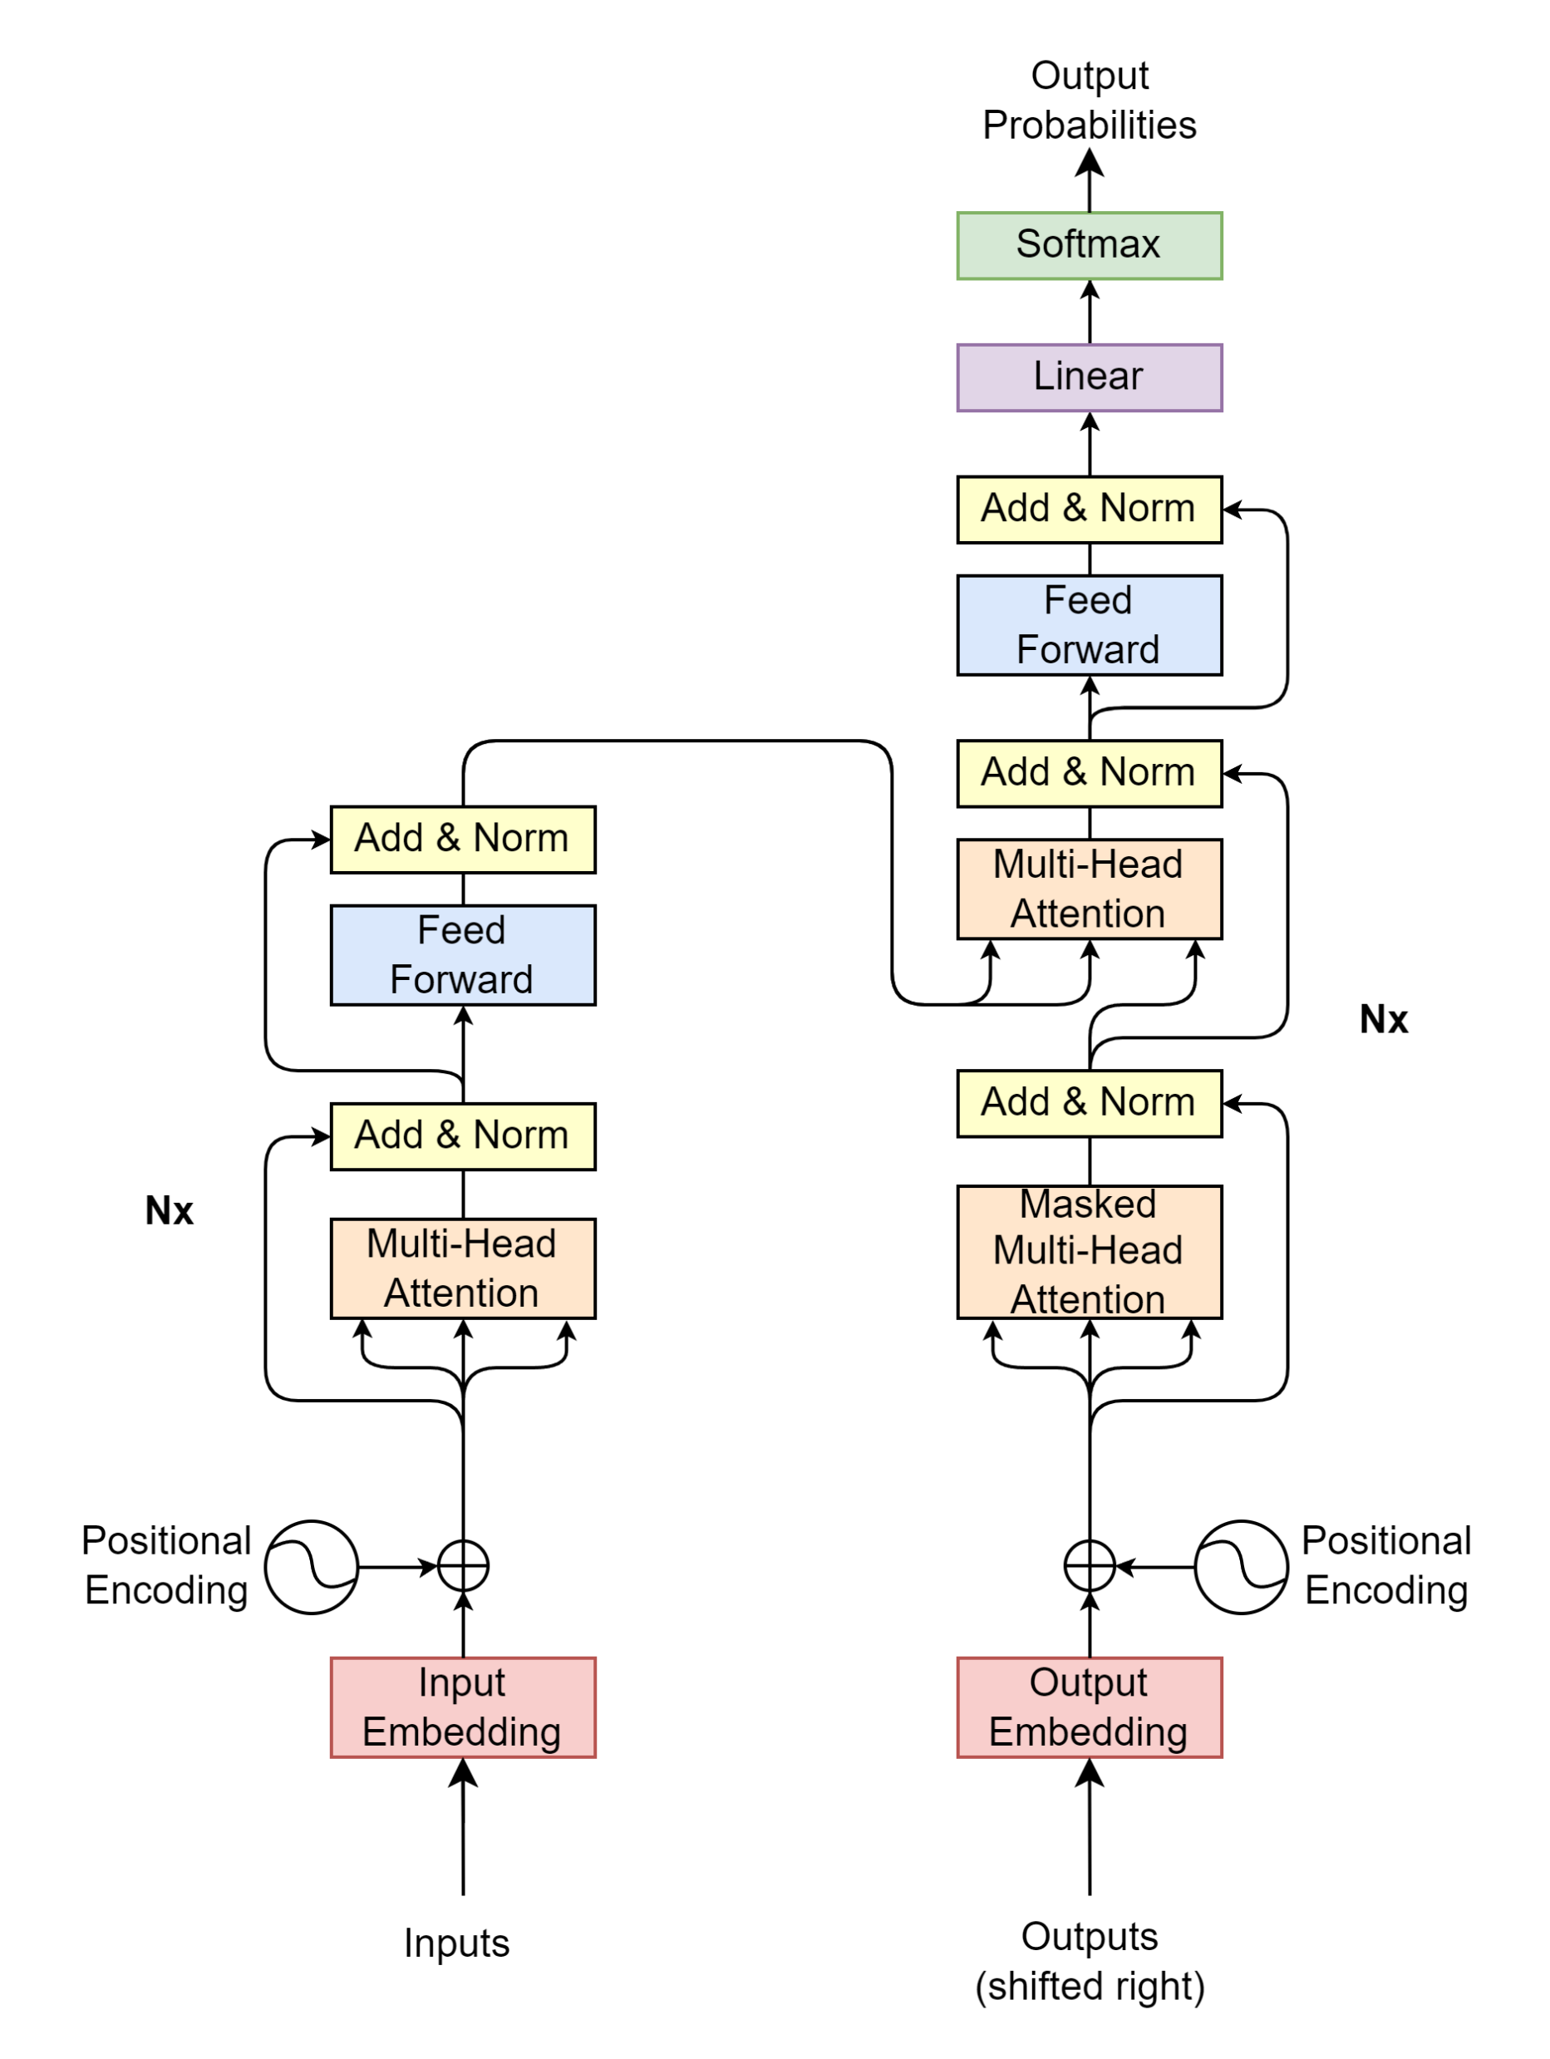

Transformer blocks
2 | 9 | 107 | 550 | 3 | 1 | 1
2 | 2089 | 95 | 75 | 120 | 3 | 1
2 | 9 | 1779 | 582 | 0 | 3 | 1
2 | 69 | 600 | 71 | 1 | 1 | 1
2 | 3546 | 324 | 1 | 1 | 1 | 1
2 | 69 | 1355 | 9 | 1390 | 5309 | 1

Slide 15
Transformer blocks
Projection
Decoder
Encoder
Encoder Input
Decoder Input

Slide 16


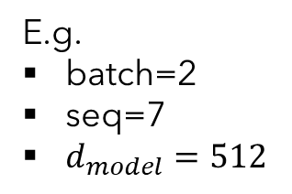




Encoder/Decoder Input
Encoder Input
E.g.
batch=2
seq=7
$d_{model}=512$
Positional
Encoding
$$\left(batch, seq, d_{model}\right)$$
$$\left(batch, seq, d_{model}\right)$$
$$\left(batch, seq, d_{model}\right)$$
Input Embedding
Inputs
$$\left(batch, seq\right)$$
2 | 9 | 107 | 550 | 3 | 1 | 1
2 | 2089 | 95 | 75 | 120 | 3 | 1
SOS | I | am | fine | EOS | PAD | PAD
SOS | Thank | you | very | much | EOS | PAD
"I am fine", "Thank you very much"

Slide 17
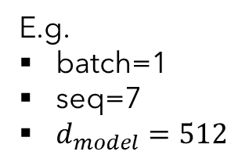



Input Embedding
E.g.
batch=1
seq=7
$d_{model}=512$
… | 523.415 | 452.716 | 7745.984 | … | … | …
… | 1265.142 | 6234.624 | 1314.124 | … | … | …
… | … | … | … | … | … | …
… | 4189.251 | 412.414 | 65.764 | … | … | …
… | 16.416 | 1794.127 | 1543.345 | … | … | …
$$d_{model}$$
$$\left(batch, seq, d_{model}\right)$$
Input Embedding
$$\left(batch, seq\right)$$
2 | 9 | 107 | 550 | 3 | 1 | 1
SOS | I | am | fine | EOS | PAD | PAD

Slide 18











Positional Encoding
E.g.
batch=1
seq=7
$d_{model}=512$
$$pos=0$$
$pos=$1
$$⋯$$
$$pos=seq−1$$
… | PE(1,0) | PE(2,0) | PE(3,0) | … | … | …
… | PE(1,1) | PE(2,1) | PE(3,1) | … | … | …
… | … | … | … | … | … | …
… | PE(1,510) | PE(2,510) | PE(3,510) | … | … | …
… | PE(1, 511) | PE(2, 511) | PE(3, 511) | … | … | …
$$i=0$$
$$i=1$$
$$d_{model}$$
$$⋮$$
$$i=d_{model}−1$$
$$\left(batch, seq, d_{model}\right)$$
PE$\left(pos, 2i\right)=\sin\left(\frac{pos}{{10000}^{\frac{2i}{d_{model}}}}\right)$
Positional
Encoding
PE$\left(pos, 2i+1\right)=\cos\left(\frac{pos}{{10000}^{\frac{2i}{d_{model}}}}\right)$
$$\left(batch, seq\right)$$
2 | 9 | 107 | 550 | 3 | 1 | 1
SOS | I | am | fine | EOS | PAD | PAD

Slide 19
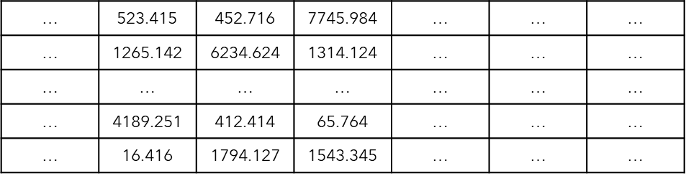
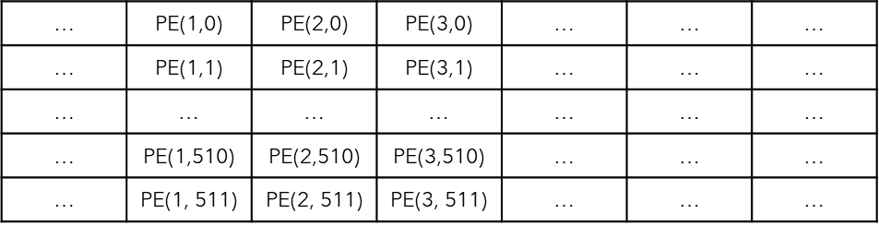
Encoder/Decoder Input
Encoder Input
E.g.
batch=1
seq=7
$d_{model}=512$
Positional
Encoding
$$\left(batch, seq, d_{model}\right)$$
$$\left(batch, seq, d_{model}\right)$$
$$\left(batch, seq, d_{model}\right)$$
Input Embedding
Inputs
$$\left(batch, seq\right)$$
2 | 9 | 107 | 550 | 3 | 1 | 1
2 | 2089 | 95 | 75 | 120 | 3 | 1
SOS | I | am | fine | EOS | PAD | PAD
SOS | Thank | you | very | much | EOS | PAD
"I am fine", "Thank you very much"

Slide 20
Transformer blocks
Projection
Decoder
Encoder
Encoder Input
Decoder Input

Slide 21
Encoder

Slide 22
Self-Attention

Slide 23
Inference
t1
Je
Decoder
Encoder
<SOS> I am fine <EOS>
<SOS>
Source:
"I am fine"

Slide 24
Inference
t2
Je
Decoder
Encoder
<SOS> I am fine <EOS>
<SOS>
Source:
"I am fine"

Slide 25
Inference
t2
vais
Decoder
Encoder
<SOS> I am fine <EOS>
<SOS> Je
Source:
"I am fine"

Slide 26
Inference
t3
vais
Decoder
Encoder
<SOS> I am fine <EOS>
<SOS> Je
Source:
"I am fine"

Slide 27
Inference
t3
bien
Decoder
Encoder
<SOS> I am fine <EOS>
<SOS> Je vais
Source:
"I am fine"

Slide 28
Inference
t4
bien
Decoder
Encoder
<SOS> I am fine <EOS>
<SOS> Je vais
Source:
"I am fine"

Slide 29
Inference
t4
Prediction:
"Je vais bien"
EOS
Decoder
Encoder
<SOS> I am fine <EOS>
<SOS> Je vais bien
Source:
"I am fine"

Slide 30
Training
Target:
"Je vais bien"
t1
Je vais bien <EOS>
Cross Entropy Loss
X Y Z
Decoder
Encoder
Update model parameters
<SOS> I am fine <EOS>
<SOS> Je vais bien
Source:
Target:
"I am fine"
"Je vais bien"

Slide 31
Training
Target:
"Je t'aime"
t2
Je t'aime <EOS>
Cross Entropy Loss
A B C
Decoder
Encoder
Update model parameters
<SOS> I am fine <EOS>
<SOS> Je t'aime
Source:
Target:
"I love you"
"Je t'aime"

